Slide 1
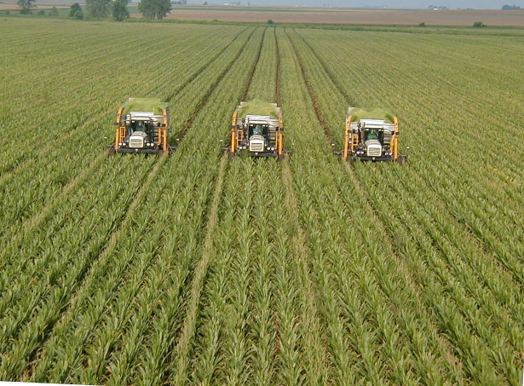
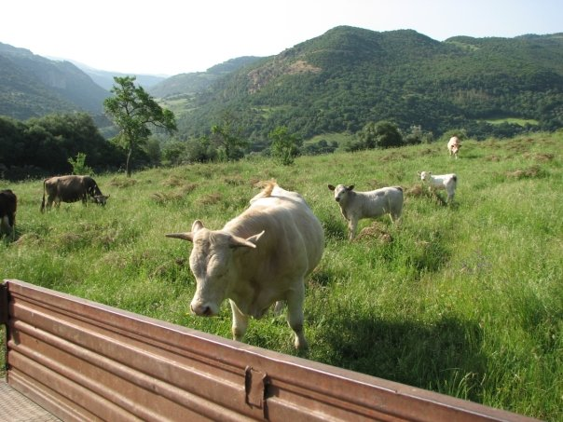
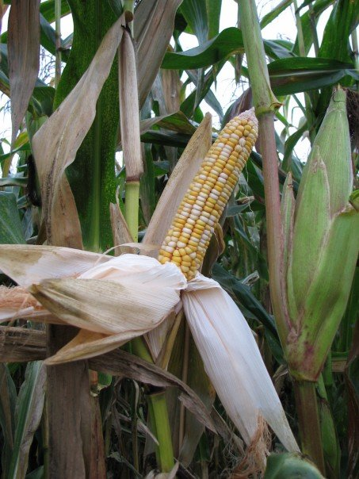
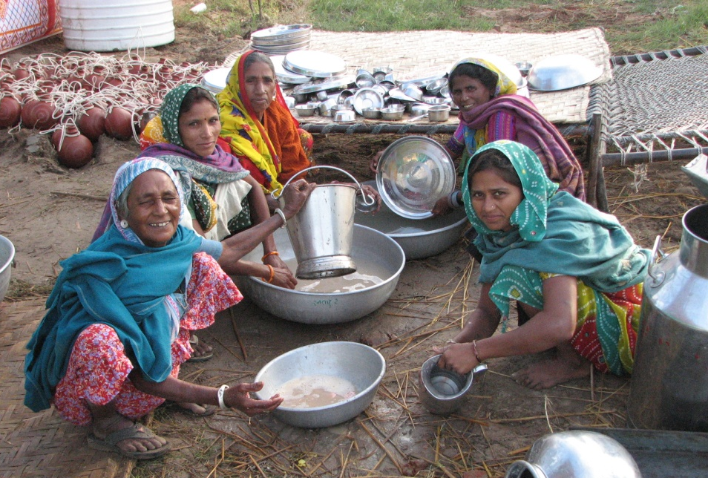
Governing Global Food Security:
The emerging architecture of global food security governance
Political Economy of Food
Centre for Food Policy
City University, London
March 12, 2012
Jessica Duncan

Slide 2
What this lecture covers
Broader context: Global governance Observable Phenomenon Political Programme
Committee on World Food Security
Civil Society Mechanism
Case study: Pastoralist Focal Points
Conclusions

Slide 3
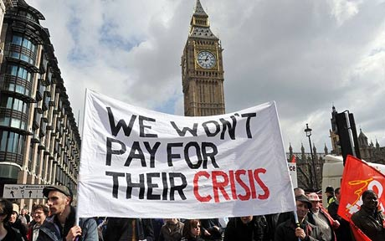

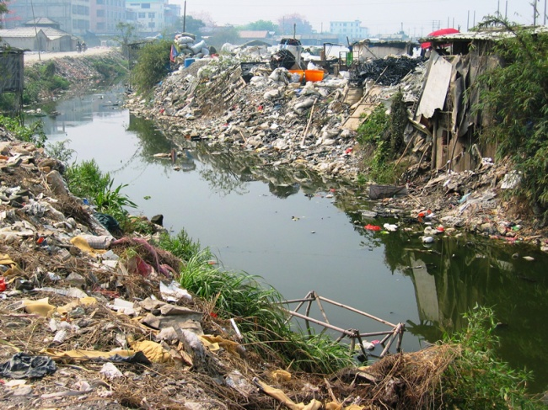
Broader Context:
A Global Governance Crisis
F-words:
Food
Fuel
Financial
We can also add:
Environmental
Notes:
How do CFS reforms relate to trends in global governance more broadly?

Slide 4
Global Governance
Governance is the process of governing. It is the way in which society is managed and how the competing priorities and interests of different groups are reconciled. It includes the formal institutions of government but also informal arrangements.
Governance is concerned with the processes by which citizens participate in decision-making, how government is accountable to its citizens and how society obliges its members to observe its rules and laws.
Governance comprises the mechanisms and processes for citizens and groups to articulate their interests, mediate their differences, and exercise their legal rights and obligations. It is the rules, institutions, and practices that sets limits and provides incentives for individuals, organizations and firms.
    FAO. 2009. Discussion Paper: Towards Voluntary Guidelines on Responsible Governance of Tenure of Land and Other Natural Resources. FAO: Rome
We can add the rules and practices that set limits and incentive for governments.
Notes:
How do CFS reforms relate to trends in global governance more broadly?

Slide 5
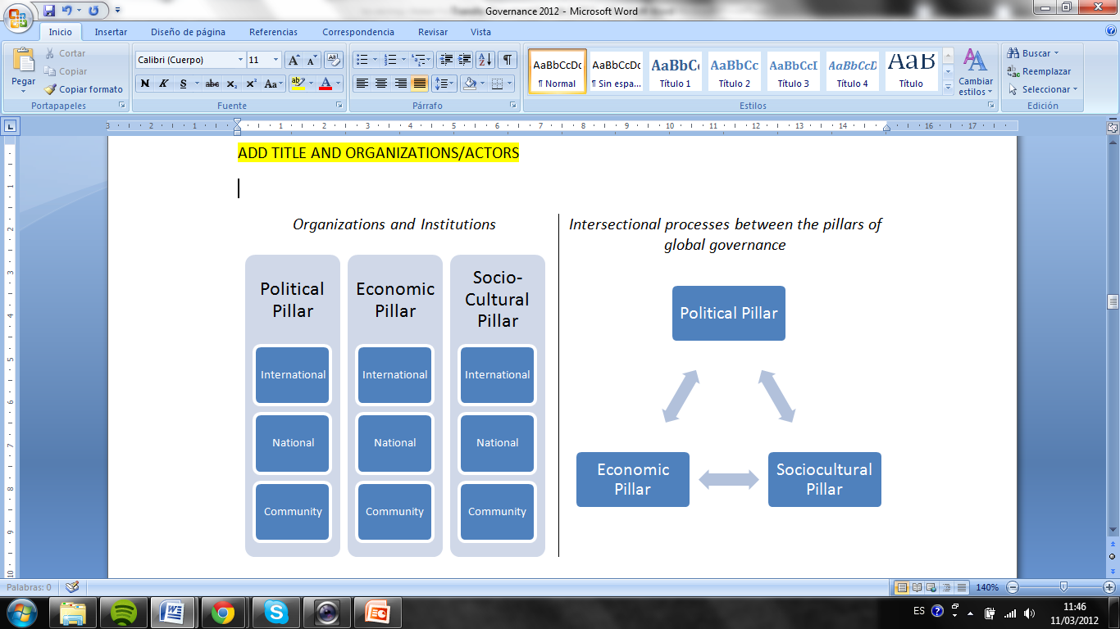
Global Governance:
The new world order
Muldoon (2004) Institutional pillars of global governance (2004: 10) and the “new world order” and the future of international organizations (2004:273)

Slide 6

Global Governance
Observable Phenomenon
Political Programme
Notes:
How do CFS reforms relate to trends in global governance more broadly?

Slide 7
Common Characterists of Global Goverance
Pluricentric rathen than unicentric
Networks play an important role
Networks function to organize relations between relatively autonomous but interdependent actors
Within contemporary governance systems, relations between actors pose risks and uncertainties. Sectors have developed institutions to support cooperation and reduce risk
      Van Kersbergen and Van Waarden (2005:151)

Slide 8
Trends in Global Governance
Vertical shifts
  Downward (Nation state or international bodies to regional actors or sub-national level)
  Upward (Nation state to International Institution with supra-national structure)
Horizontal shifts
  Executive and legislative powers to juditiary
  Public to Semi-Public or Private Sector
Network Governance

Slide 9
Global Governance as a Political Programme
Neoliberal project
  Embedded neoliberalism
Diversity of actors
Shifting roles: state, private sector, civil society, philanthropic
New alliances: G20, G77, African Union, GRULAC, civil society, private sector

Slide 10
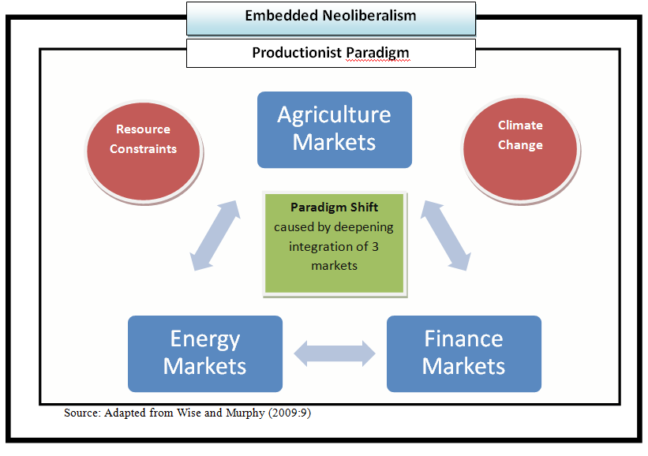
Paradigm shift influencing the new architecture of global food security governance

Slide 11
Global Governance and Food Security: Case Study
Global Agriculture and Food Security Program (GAFSP)
Through GASFP, processes of upward and downward vertical shifts are taking place
Countries with an interests in supporting food and agricultural in the world’s poorest countries have shifted their efforts upwards to a global initiative
As the same time, the GAFSP has committed to consult with stakeholders at the country-level, a process illustrative of a downward shift
Here we see, if not a total shift, at least a dependent relationship from a global, or supra-national, organization down to the sub-national level
The GAFSP relies on these consultations and the future implementation of projects by local stakeholders as part of their claim to legitimacy
Limits: productionism, neoliberalism, “don´t bite the hand that feeds”

Slide 12
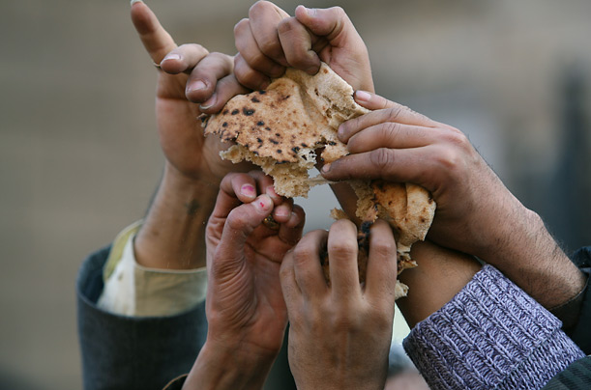
Key Challenges
Global?
Accountability
Legitimacy
Participation
Transparency
Monitoring and evaluation
Policy cohesion (State sovereignty vs. international objectives
Finding agreement amidst diversity: clashing paradigm

Slide 13
The Committee on World Food Security
Global Governance in Action

Slide 14
Committee on World Food Security
1974: Established upon recommendation of the World Food Conference
  Response to 1970s food crisis
2009: 35th Session of the CFS: Reform process initiated
  Goal of reform was to focus vision and role in the coordination of efforts to ensure global food security
2010: 36th Session = first of the Renewed CFS

Slide 15
Key Actors and Organizations
CFS is made up of 192 Member Governments, participants (i.e., Civil Society Organizations, NGOs, Private Sector) and observers
  They make up the Plenary
Bureau: Executive Arm (12 countries, 2 per region)
Advisory Group: UN Bodies, CSOs/NGOs; International Agricultural Research Bodies; International Financial and Trade Institutions; Private Sector/Philanthropic Foundations
High Level Panel of Experts: Steering Committee and Roster of Experts
Secretariat: Permanent, located in Rome and includes member of IFAD, and WFP
Notes:
Chair: Dr. Noel De Luna (Agricultural Attaché,Philippines)
Members:
Algeria
Australia
Belgium
Brazil
Egypt
Equatorial Guinea
Guatemala
Japan
Jordan
Malaysia
Russian Federation
USA

Slide 16
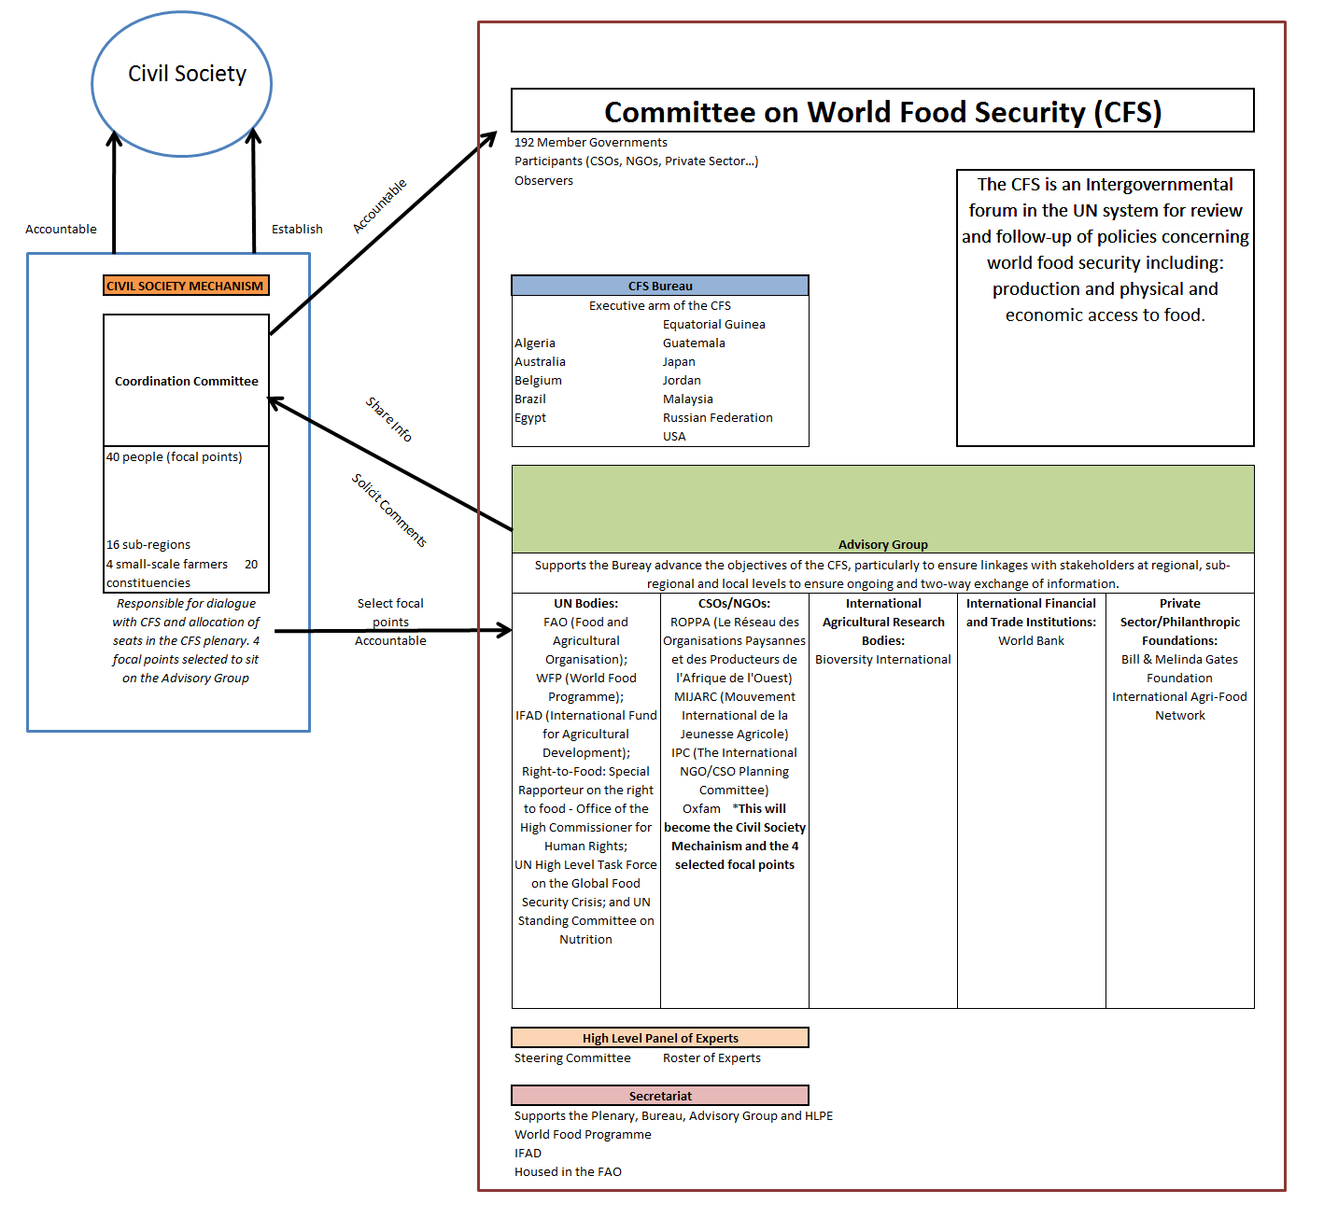

Slide 17
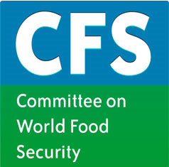
CFS Reform: Key Points
The vision of the reformed CFS:
  Central decision-making and discussion forum for food security within the UN
  Work in a coordinated manner in support of country led processes that lead to food security.
Using a phased approach CFS will:
  Coordinate a global approach to food security
  Promote policy convergence
  Support and advise countries and regions
  Coordinate at national and regional levels
  Promote accountability and share best practices
  Develop a global strategic framework for food security and nutrition
    From http://www.fao.org/cfs/cfs-home/cfs-about/en/
Notes:
The reforms position the CFS as the central decision-making and discussion forum for food security within the UN.
The Renewed CFS aims to give voice to stakeholders in the world food system, and encourage the exchange of experience, knowledge, evidence and scientific analysis.
It is also charged with monitoring the effectiveness of actions taken to improve food security.

Slide 18
Key Issues Addressed by the CFS
At the 36th Session, 3 policy roundtables were presented:
  Addressing Food Insecurity in Protracted Crises: Issues and Challenges;
  Land Tenure and International Investment in Agriculture; and,
  Managing Vulnerability and risk to promote better food security and nutrition.
Discussions on Mapping FS initiatives and the development of a GSF
Session on global developments relevant to food security and nutrition
HLPE undertake studies on: Land tenure and international investment in agriculture; and, Price volatility
CFS to decide on Land Tenure and Investment (RAI & VG)
Notes:
KEY ISSUES ADDRESSED BY THE CFS: At the 36th Session of the CFS, 3 policy roundtables were presented:
Addressing Food Insecurity in Protracted Crises: Issues and Challenges;
Land Tenure and International Investment in Agriculture; and,
Managing Vulnerability and risk to promote better food security and nutrition.
There were also discussions on how to undertake and coordinate the mapping of food security initiatives as well as the development of a Global Strategic Framework for the CFS.
The 36th Session hosted a session on global developments relevant to food security and nutrition to ensure member states and other participants were made aware of recent initiatives. The purpose of the session was to share information and consider how existing global initiatives can most effectively work together and with the CFS so as to promote coherence and maximize impact.
For the 2010-2011 year, the CFS has requested that the HLPE undertake studies on the following issues:
Land tenure and international investment in agriculture;
Price volatility;
It was also proposed that the CFS start an inclusive process to consider the Principles for Responsible Agricultural Investment that Respect Rights, Livelihoods and Resources (RAI) within the CFS, and to encourage the development of the Voluntary Guidelines on the Responsible Governance of Tenure of Land and Other Natural Resources (VG).

Slide 19
Key Issues Addressed by the CFS
At the 37th Session, 3 policy roundtables were presented:
  Supporting investment in small-holder agriculture
  Food Price Volatility
  Food Security, Gender and Nutrition
For 2012 (38th Session):
  High Level Expert Forum on Food Security in Protracted Crisis
  Policy Roundtables on: Food Security and Climate change; Social protection
  Presentation of draft 1 of the Global Strategic Framework.
Notes:
KEY ISSUES ADDRESSED BY THE CFS: At the 36th Session of the CFS, 3 policy roundtables were presented:
Addressing Food Insecurity in Protracted Crises: Issues and Challenges;
Land Tenure and International Investment in Agriculture; and,
Managing Vulnerability and risk to promote better food security and nutrition.
There were also discussions on how to undertake and coordinate the mapping of food security initiatives as well as the development of a Global Strategic Framework for the CFS.
The 36th Session hosted a session on global developments relevant to food security and nutrition to ensure member states and other participants were made aware of recent initiatives. The purpose of the session was to share information and consider how existing global initiatives can most effectively work together and with the CFS so as to promote coherence and maximize impact.
For the 2010-2011 year, the CFS has requested that the HLPE undertake studies on the following issues:
Land tenure and international investment in agriculture;
Price volatility;
It was also proposed that the CFS start an inclusive process to consider the Principles for Responsible Agricultural Investment that Respect Rights, Livelihoods and Resources (RAI) within the CFS, and to encourage the development of the Voluntary Guidelines on the Responsible Governance of Tenure of Land and Other Natural Resources (VG).

Slide 20
Civil Society Mechanism
CSM facilitates the participation of CSOs and NGOs in the CFS, including input in negotiations and decision-making
Provides a space for dialogue between a wide-range of civil society actors
Made up of a Coordination Committee (CC) comprised of 41 focal points from 11 constituencies and 17 sub-regions

Slide 21
Sub-Regions (Total of 16, x1 focal point each)
North America | South East Asia
Central America & Caribbean | Central Asia
Andean Region | Oceania
Southern Cone | Southern Africa
Western Europe | West Africa
Eastern Europe | East Africa
West Asia | Central Africa
South Asia Pacific | North Africa
Constituencies (Total of 24, x2 focal points each)
Agricultural & food workers | NGOs
Artisanal fisherfolk | Smallholder family farmers (4 focal points)
Consumers | Urban poor
Pastoralists | Women
Indigenous Peoples | Youth
Landless

Slide 22
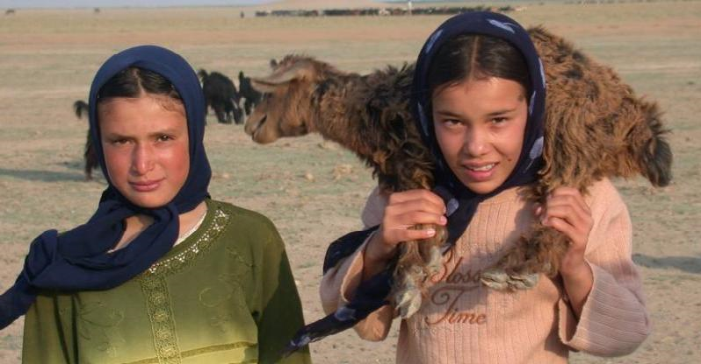
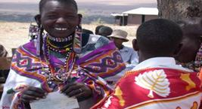
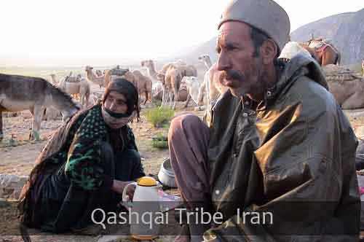
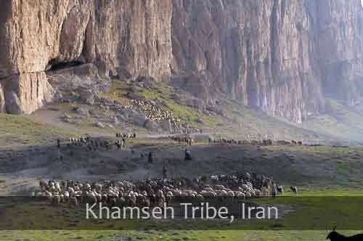
Pastoralists
Notes:
Segue to talk about one of the focal points and their experience with the CSM and the CFS.
At the CSM consultation (Oct 2010) the pastoralists present decided that the focal points would be elected at the Global Gatheirng for Pastoralist Women (November 2010) Mera, India.
I attended to support with documentation and coordination.

Slide 23
What is Pastoralism?
Pastoralism is a socio-cultural and economic way of living that relies on rearing livestock on marginal lands and is sustained through migration
  Includes nomadism and transhumance
Animals include cattle, yaks, sheep and goats, horses and donkeys, camels (both one- and two-humped), llamas and alpacas, and reindeer
Notes:
According to the World Initiative for Sustainable Pastoralism (WISP):
Mobile pastoralists are a large and significant minority, and often an ethnic minority, in many countries around the world. Precise figures are hard to come by, but when all types of mobility are considered, nomadic and transhumant pastoralists may number between 100 and 200 million people globally. If extensive agro-pastoralists are included, the number rises very sharply, and such people are often a clear majority of dryland inhabitants.
See WISP. 2008. Pastoralism. Available: http://iucn.org/wisp/pastoralist_portal/pastoralism/

Slide 24
Why a Global Gathering?
The goal of the Gathering was to contribute to the empowerment of women pastoralists in order for them to participate equitably in decision-making within their communities, governments and other local, national, regional and international forums, whilst also raising awareness of the specific challenges faced by women pastoralists in shifting social, economic and ecological environments.

Slide 25
Why pastoralists, why women, why India?
Pastoralism, notably mobile pastoralism, is the most viable form of production and land use for most of the world’s fragile drylands. Yet it is under increasing legal, economic, social and political threat
Women play a crucial role within pastoralist communities
India’s pastoralist population of approximately 100 million, come from diverse cultural groups and rear a variety of livestock.
  Women have traditionally played key roles in the communities
  Changes in India: White Revolution; Forest Rights Act
Notes:
These threats are often subtle and take the form of disincentives and barriers, primarily restricting mobility of livestock. Despite evidence clearly illustrating the important environmental services performed by pastoralists, they are subject to great misunderstanding, as well as social, economical and political marginalization, often as a result of perceived administrative problems posed by their mobile livelihoods. Migratory routes are being blocked and grazing land seized for industrial and other non-agricultural uses. Many conservation efforts have created nature reserves along traditional migratory routes and now restrict access or prohibit pastoralists from passing through with their animals. Many pastoralists are denied the right to vote and have no voice in political processes. There are also challenges with respect to ensuring education for their children and securing proper medical care. Often these forces lead pastoralists to become sedentary.
Negative stereotypes portrayed through the media and by politicians create social barriers for pastoralists. Indeed, a theme that was repeated again and again throughout the Gathering was the need to improve the image of pastoralists in the media.
Women play a crucial role within pastoralist communities both as keepers of livestock as well as maintainers of family cohesion. Yet women are greatly marginalized due to limited decision-making opportunities within their societies and restrictive gender roles, making their struggle within pastoralism more broadly all the more complex. Despite the challenges they face, women pastoralists have been active participants in global policy dialogues and the Gathering highlighted and built upon this.

Slide 26
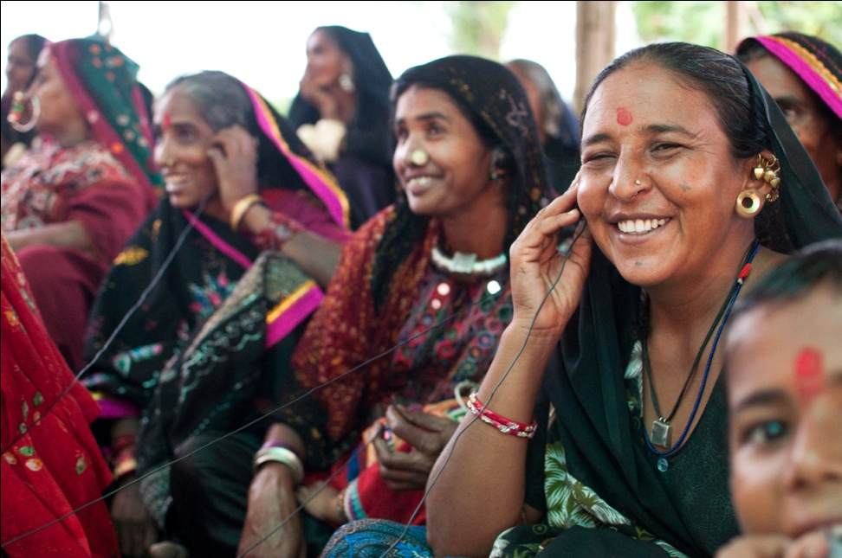
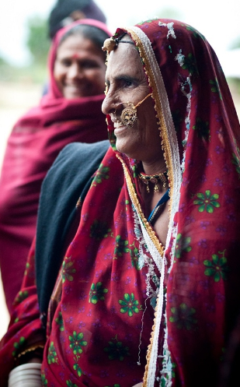
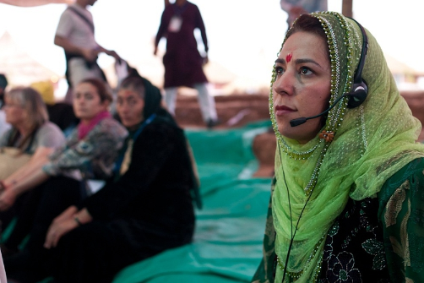
Global Gathering of Women Pastoralists
Notes:
Brought over 100 women from 31 countries together
Mera, India – Province of Gujarat
The Gathering was held in a rural setting in an area of Gujarat that is used and inhabited by pastoralists
Rural setting provided ideal location for skills sharing, concentration, focussing on our agenda
Also provided many challenges (electricity, internet, sanitation, access/transportation)

Slide 27
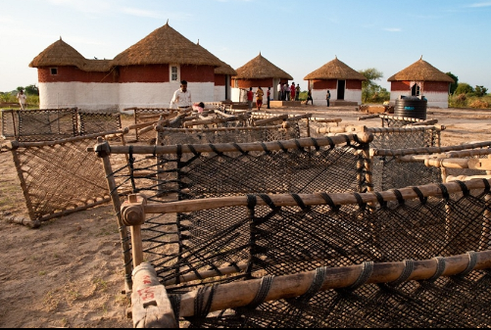
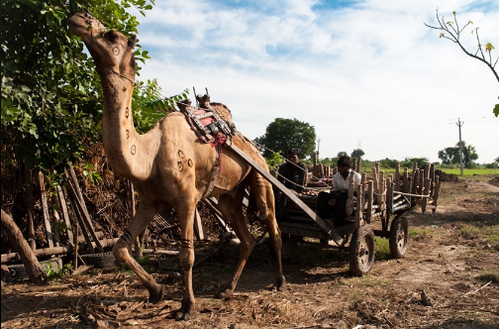
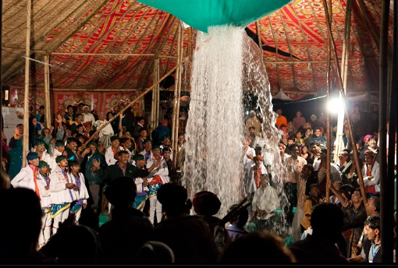
Global Gathering of Women Pastoralists
Notes:
The campus is meant to be a safe place for pastoralists to stop and also a school.
The week after we left india, they hosted school children at the site.
Trying ti build an eco-resort facility on the campus.
BUNGAS – traditional huts, cow dung and thatch roof
The surrounding communities donated their beds and a lot of labour to the event, highlighting the importance of the event for the community.
Over 300 beds were donates and also decorations for the bungas and tents
WE had a local cooking and cleaning crew.
All was going well until the typhoon.
We were evacuated from the site to a community centre nearby.
The campus recovered.

Slide 28
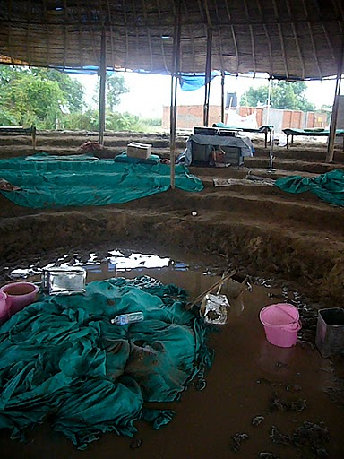
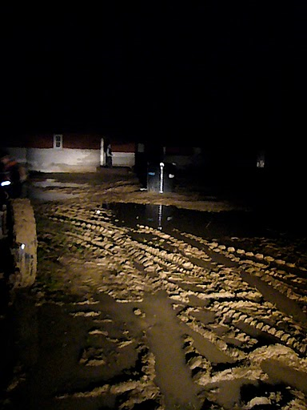
Climatic Variability: Rains came early

Slide 29
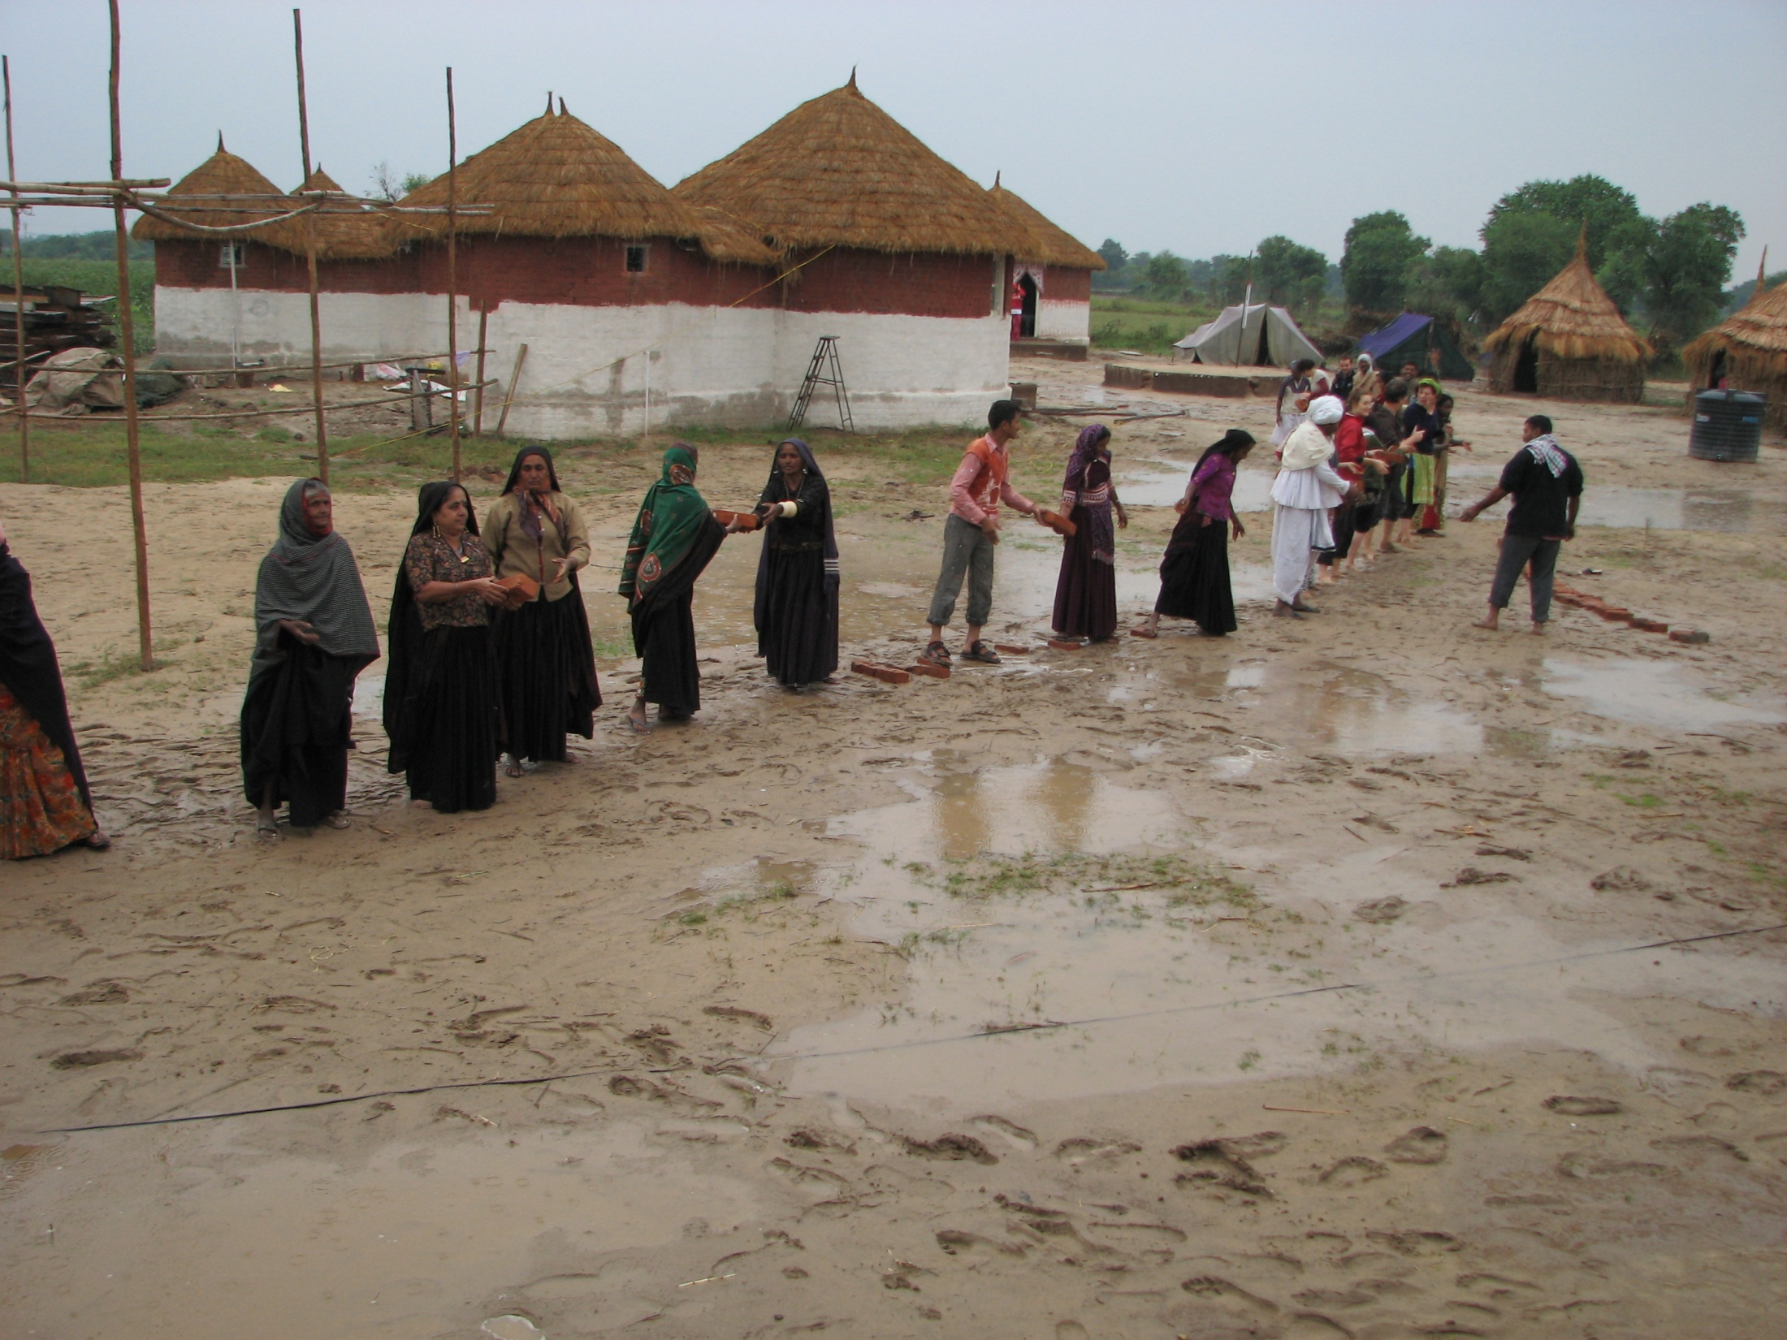
Team Work: Building a path forward
Notes:
Admitedly cheesy, but this was a remarkable event that brought together women from around the world to exhange expeiences and knowledge, for more than the sake of networking itself. It set the tone for the Gathering: reinforced the value of working together. The Gathering was structured around a flexible programme that was designed to provide time for cultural events, skills sharing, regional discussions and discussions around themes of interest. Every effort was made to ensure that women’s voices were heard and towards this end, interpreters and interpreting equipment was made available for participants and facilitators gave priority to women participants.
Only pastoralist women had delegate status. However, men and other women were able to attend as observers. Observers were able to fully participate in the Gathering but did not have the right to vote.
SCHEDULE:
Opening Ceremony: concerns that it was male dominated
Day 1- geocultural working group – visioning
WHY GEOCULTURAL: First, some groups which are geographically close may share very little culturally or even climatically, whereas at times, groups which are perhaps farther away could share similar cultural and geographic traits, and would perhaps be better able to support one another in their workgroups. This is to say that proximity does not necessarily make for the most logical groupings. This grouping also speaks to the fact that these are transhumant people who may cross borders and interact with peoples in different states. Finally, the term draws attention to the fact that pastoralism is rooted in culture and geography and that both of these factors are fundamental in the ways of life of pastoralist peoples.
Day 2- thematic working Group – visioning
Established by working committee and then adapted by participants based on need.
Education, Health, and Communication; Access to Markets; Men’s Group; Natural Resources
Day 3 – skills sharing and community visit
Day 4- action plan, CSM election, declaration writing

Slide 30
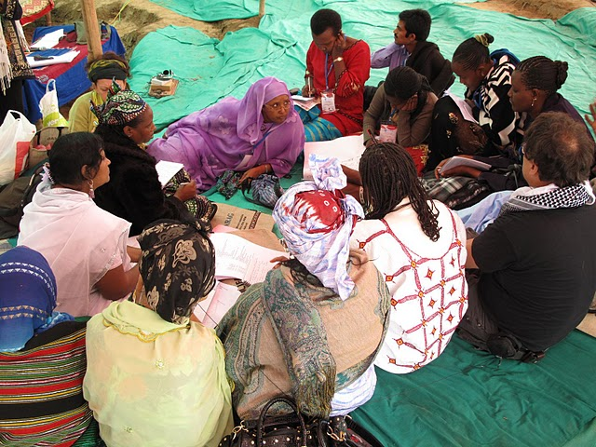
Top Priorities
Representation
Communication and Networking
Education, Training and Capacity Building
Advocacy
Development
Notes:
On the last day of the Gathering, participants met and together came up with a list of their top priorities, which included:
Representation
Communication and Networking
Education, Training and Capacity Building
Advocacy
Development

Slide 31
Key Outcomes:
Global Gathering of Women Pastoralists
Mera Declaration
Action Plan (2011-2013)
Global network of pastoralist women
Enhanced networks and communication
Awareness building (media)
Advocacy (links to Mera Declaration)
    e.g., presented at UNPFII
Election of 2 CSM Focal Points
  Next Steps: Working on regional-level follow up
Notes:
UN Permanent Forum on Indigenous
For the Mera Declaration Writing Group, geo-cultural groups recommended one or two women as representatives to support the drafting of the Declaration.
This group took the main issues addressed at the Gathering and used them to develop the Mera Declaration.
The Declaration was read out to participants on the last evening of the Gathering to ensure each of the participants felt the declaration included the necessary recommendations and information pertaining to their struggle as women pastoralists.
Due to technological limitations, we were unable to project the Declaration or distribute it to participants prior to the reading and approval.
One participant noted the importance of being able to carefully read and consider the document prior to approval.
However, despite these challenges, the Mera Declaration was unanimously approved and thus adopted.

Slide 32
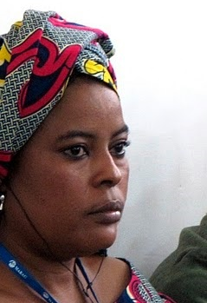
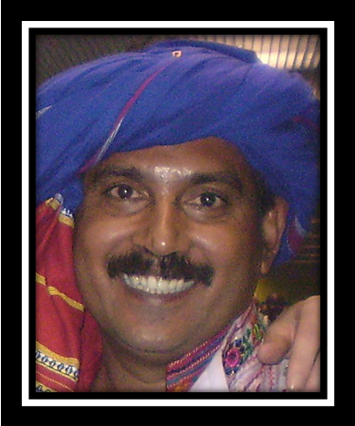
Focal Points: Pastoralists
Safouratou Moussa Kané
Niger
Lalji Desai
India
Notes:
Safouratou is an active member of AREN (Association pour la Redynamisation de l’Elevage au Niger) and since 2007 she has served as Vice President of the West Africa Network of Pastoralists and Breeders (RBM) where she is committed to take better account of the concerns and voices of women in decision-making bodies, with the ultimate goal of achieving genuine autonomy for women pastoralists in West Africa.
Lalji was born into a traditional pastoral family. In 1988, he joined Aga Khan Rural Support Programme (INDIA), thus beginning his career as community organizer. In 1994, Lalji became a founding member of MARAG (Maldhari Rural Action Group) where he worked for the rights the Maldhari people (pastoralists of Gujarat Province). Lalji is also the Convener Maldhari (Pashu Palak) Maha Sabha Lalji and is thus responsible for the Indian network of Pastoralist in more than 10 states.
At the international level, in 2007, he participated in the WAMIP World Pastoral Gathering and was elected as a WAMIP counselor and treasurer. Here he also participated on the Segovia Declaration writing committee.

Slide 33
ConCLUSIONS

Slide 34
What to keep an eye on
G20 - Mexican Presidency plans to maintain development & food security focus (AFSI)
Rio +20
WB – triple-threat
SUN – will nutrition re-surface, if so, what are the implications?
New Executive Director for World Food Programme (WFP)
Committee on World Food Security (CFS)
  RAI negotiations in OEWG of CFS (Chair = Switzerland)
  Adoption and implementation of the VG on the Responsible Governance of Tenure of Land, Fisheries and Forests in the Context of National Food Security (VGs) – Links to RTF
  Negotiations on the Global Strategic Framework (GSF)

Slide 35
Take Away Messages
Food systems face a governance crisis that extends to a broader crisis of global governance
The architecture of food security governance has shifted in response to the food crisis and with the emergence of new actors
Policy priorities for food security: Emergency aid; Policy cohesion; Increased Productivity; Improved Markets
  Multiple interpretations

Slide 36
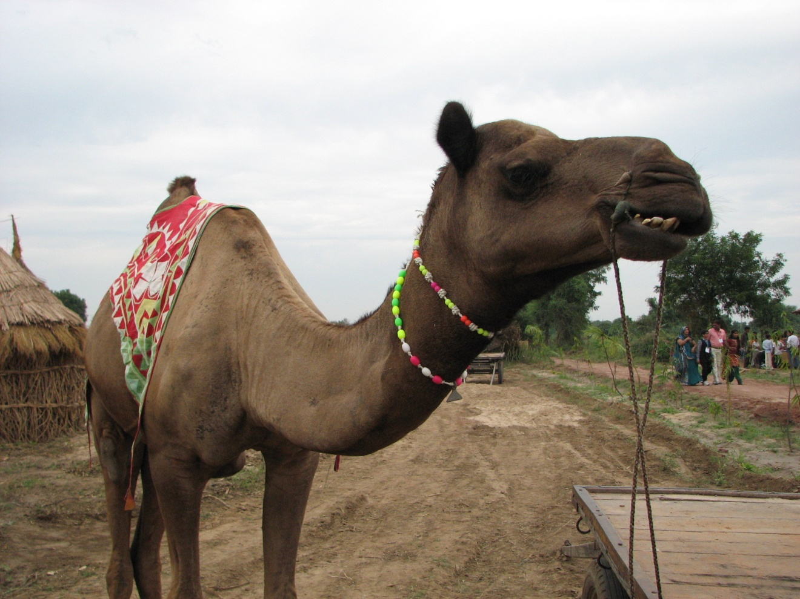
THANK YOU!
Download Presentation: foodgovernance.com

