Slide 1
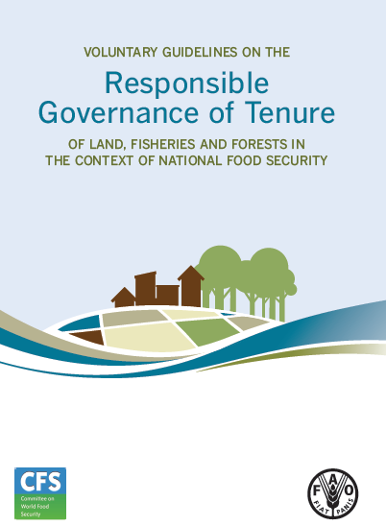
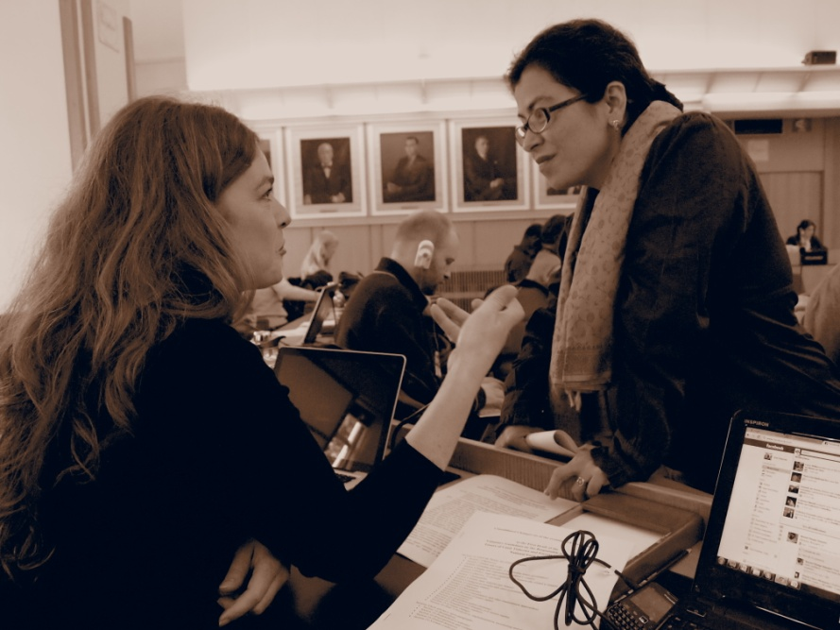

Voluntary Guidelines on the Responsible Governance of Tenure of Land, Fisheries and Forests in the Context of National Food Security (VGGT):
A Case Study in the effectiveness of the Reformed Committee on World Food Security
Jessica Duncan
Centre for Food Policy,
City University London

Slide 2
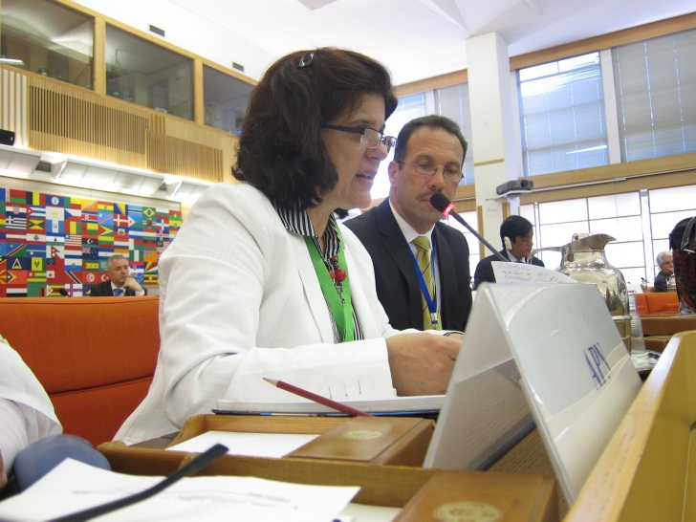
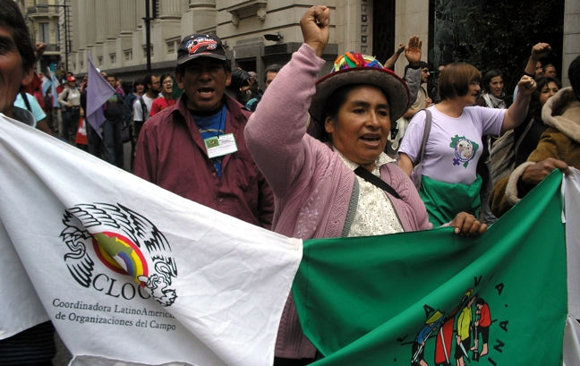
Structure of the Presentation
Part 1 | Setting the Scene: Reform of the Committee on World Food Security Development of the Civil Society Mechanism Aim: provide context for, and awareness of, reform of the CFS
Part 2 | Methods: Doing participant observation Solidarity research Aim: to review participant observation as solidary research method ;
Part 3 | Case Study: VGGTs Aim: illustrate the role of CSOs in negotiations; provide a review of the Guidelines; reflect on the future of the CFS

Slide 3
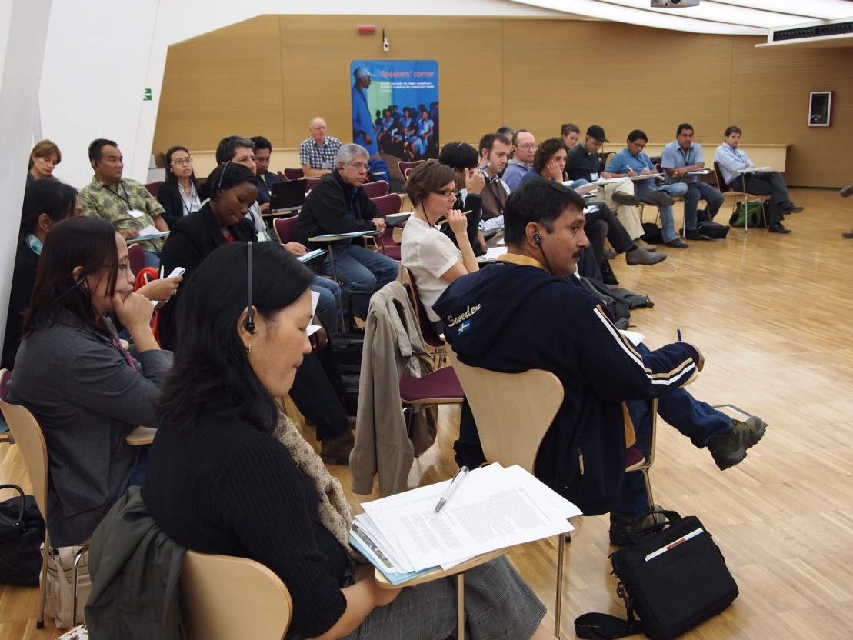
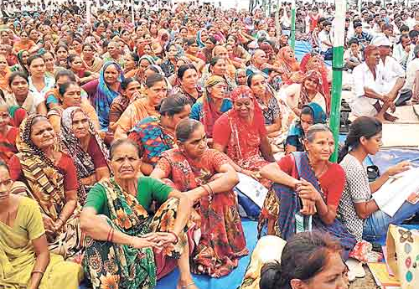
PART 1- Setting the Scene
Bridging the gap: Global governance – local governance

Slide 4
Catalyst for Change
Between 2007 and 2008, the world’s staple food prices soared to their highest levels in 30 years: more than 1 billion people were chronically hungry
Prices peaked in June 2008 (but then fell 33% in 6 months)
Food riots broke out in more than 60 countries
Rising food costs in 2010-11 pushed nearly 70 million people into extreme poverty
Marked by 7 main policy reactions: Policy coherence and cohesion; Relief; Increased Productivity; Improved Markets; Increased Investment; Country-led Plans; Sustainability
Battle for leadership: coherence = highly political

Slide 5
Committee on World Food Security
1974: Established upon recommendation of the World Food Conference (Response to 1970s food crisis)
2009: Reform process initiated to address calls for greater coordination and cohesion of food security policies
2010: First Session of the Renewed CFS (36th)
Now: Emerging consensus that the CFS is the forum for discussion and debate on global food security governance (rhetoric vs practice)

Slide 6
Vision of the CFS
“To constitute the foremost inclusive international and intergovernmental platform for a broad range of committed stakeholders to work together in a coordinated manner and in support of country-led processes towards the elimination of hunger and ensuring food security and nutrition for all human beings”

Slide 7
Key Issues Addressed by the CFS
CFS | Issue
36 (2010) | Addressing food insecurity in protracted crises: Issues and Challenges
 | Land tenure and international investment in agriculture
 | Managing vulnerability and risk to promote better food security and nutrition
37 (2011) | How to increase food security and smallholder-sensitive investment in agriculture
 | Gender, Food Security and Nutrition
 | Food Price Volatility
 | Methods for calculating number of food insecure
38th (2012) Extraordinary | Voluntary Guidelines on the Responsible Governance of Tenure of Land, Fisheries and Forests in the Context of National Food Security
39 (2012) | Climate Change
 | Social Protection
 | Global Strategic Framework
 | Principles for Responsible Agricultural Investment
40th (2013) | Investing in smallholder agriculture for food security and nutrition
 | Biofuels and food security

Slide 8

Civil Society Mechanism
CSM facilitates the participation of CSOs in the CFS, including input in negotiations and decision-making
Provides a space for dialogue between a wide-range of civil society actors
Facilitates local struggles into political processes
Open to all CSOs working on food security
Executive: Coordination Committee (CC) comprised of 41 focal points from 11 constituencies and 17 sub-regions
www.csm4cfs.org

Slide 9
Sub-Regions (Total of 17, x1 focal point each)
North America |  | South East Asia
Central America & Caribbean |  | Central Asia
Andean Region |  | Oceania
Southern Cone |  | Southern Africa
Western Europe |  | West Africa
Eastern Europe |  | East Africa
West Asia |  | Central Africa
South Asia |  | North Africa
Pacific
Constituencies (Total of 24, x2 focal points each)
Agricultural & food workers | NGOs
Artisanal fisherfolk | Smallholder family farmers (4 focal points)
Consumers | Urban poor
Pastoralists | Women
Indigenous Peoples | Youth
Landless

Slide 10
CSM Working Groups
Role of CSM Working Groups
Working Groups
To enhance circulation of relevant documentation and information on the issue and on the related process in the CFS
To provide a space for dialogue and the exchange of views
To provide a space for CSOs to develop strong civil society positions
Land Tenure
Agricultural Investment
Global Strategic Framework
Gender
Nutrition
Price Volatility
Protected Crisis and Conflict
Monitoring and Mapping
Social Protection
Climate Change
Biofuels
CFS Programme of Work

Slide 11
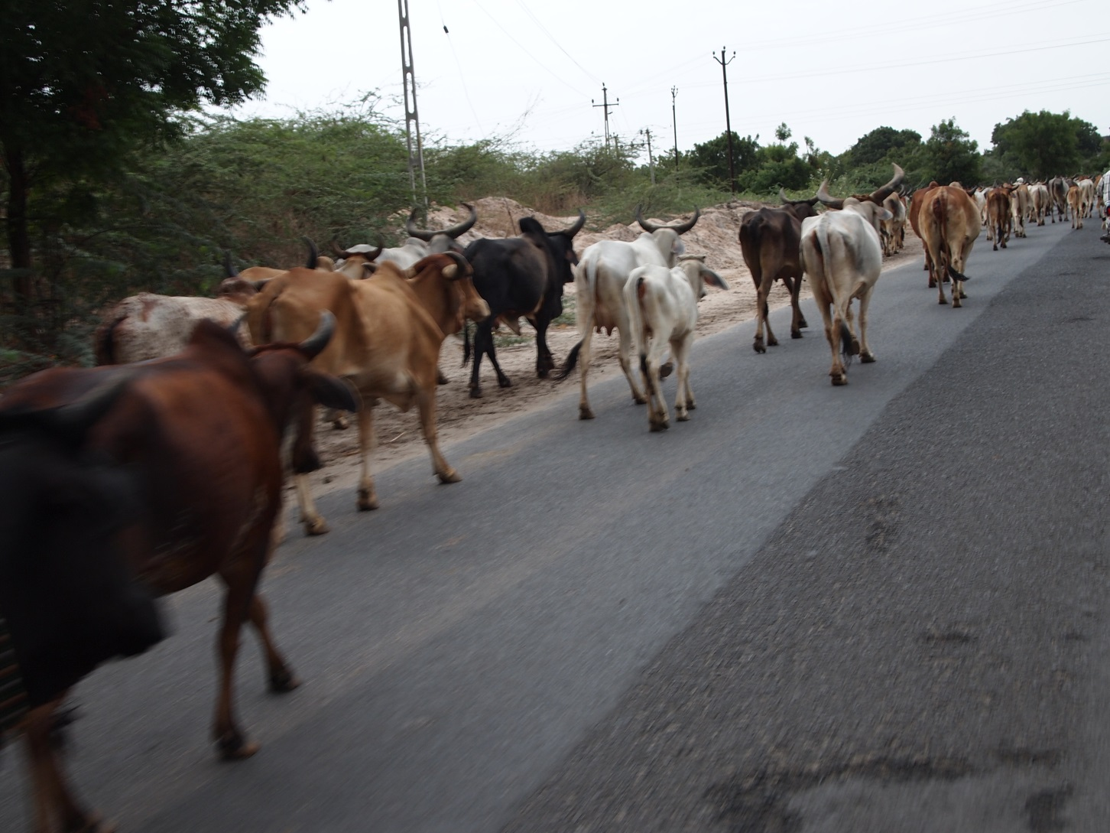
PART 2- Participant Observation

Slide 12
Aims of this Section
Make a case for participant observation (in solidarity with food social movements)
Discuss how and why I conducted fieldwork (as solidarity research) in a UN committee
Identify some of the challenges I faced/lessons learned
Frame the case study

Slide 13
“The Field”
The “field” is not an objective place
Site of reciprocal and contested relationships (Domosh 2003)
Site where actors co-construct meaning through various forms of interaction
These meanings are not static: they are continuously constructed, reconstructed, deconstructed, and enacted through interactions (or lack of thereof)
It is important not to assume that shared experience results in shared meaning
CFS = Interface space which constitutes “important terrains for confrontations between social movements and the defenders of the neoliberal agenda that has dominated the world’s community’s discourse and actions over the past 3 decades” (McKeon 2009:48)

Slide 14
Benefits of Participant Observation/Solidarity Research
For Participant Observation:
  Interviews = limited, actions don’t always align with words
  Vantage point – as a co-constructor of meaning
For Solidarity Research:
  Social movements produce knowledge
  Connected by virtue of your position
Social movements = conducive sites to privilege meaning-making: activities foreground resistance to dominant norms and institutions (Kruzman 2008)
  Reinforced through interviews with CFS negotiators
Raise possibilities of alternative world-views which challenges those engaged to rethink meanings often taken for granted

Slide 15
Doing Participant Observation
What I needed
Gate keepers
Flexibility (a must)
Consultation
Feedback
Hard work
Language
  Cultural and linguistic
  Fundamental role of interpreters: voice -trust
  Value of English (*)
Blog
  Transparency
  Public profile
  Exposure
  Remaining a-political (*)
  Networking tool
  Motivation
  Archive of thinking and process

Slide 16
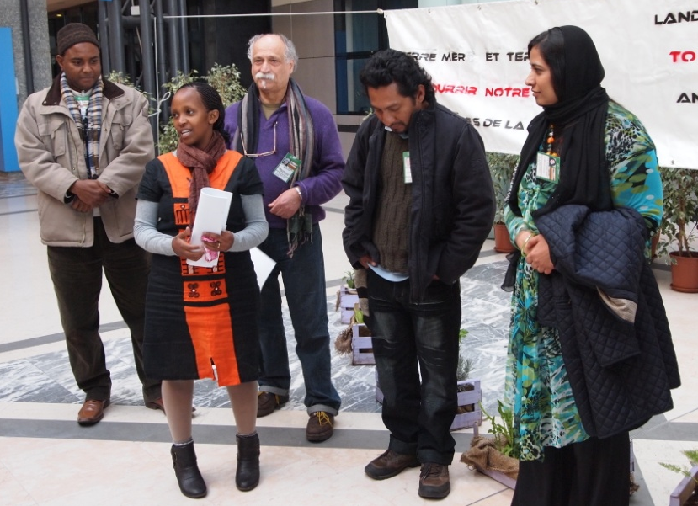
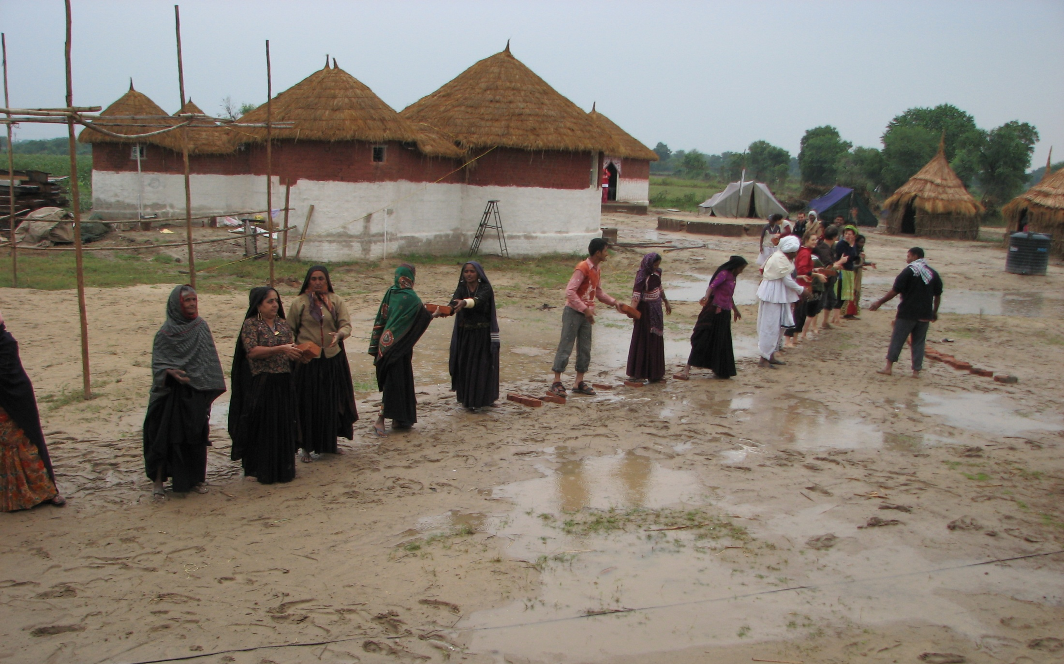
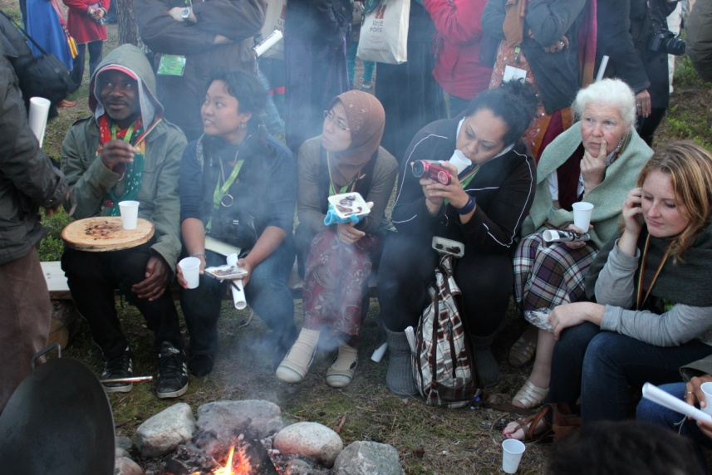
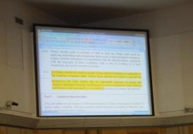
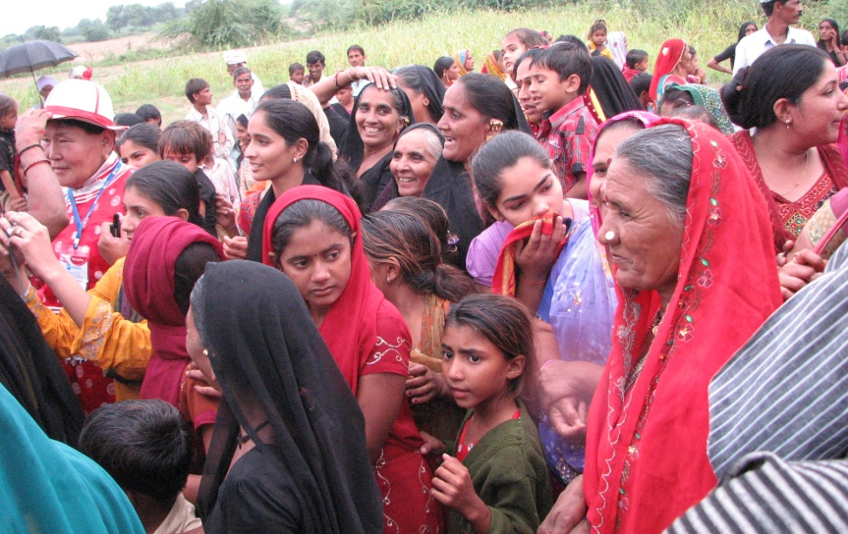
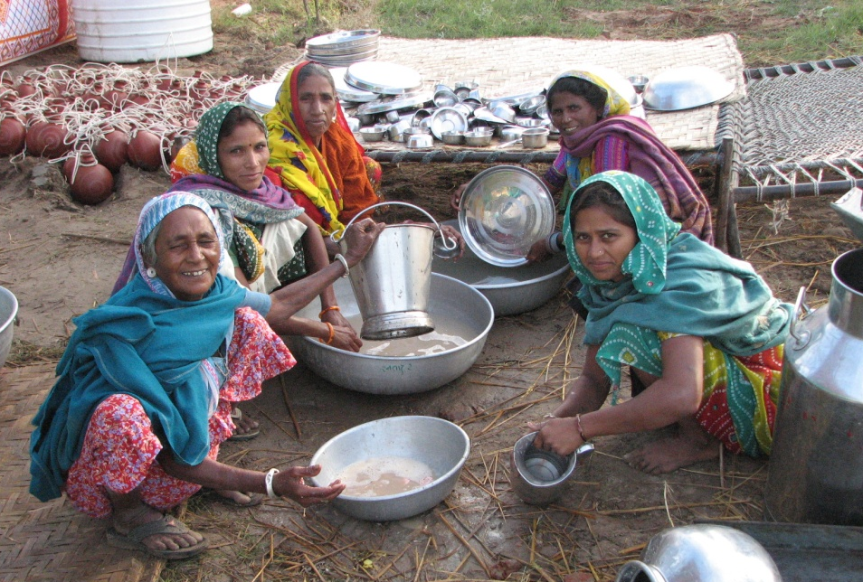
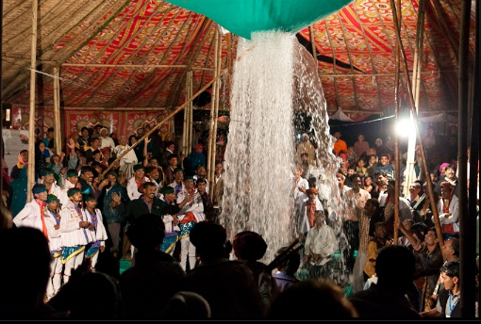
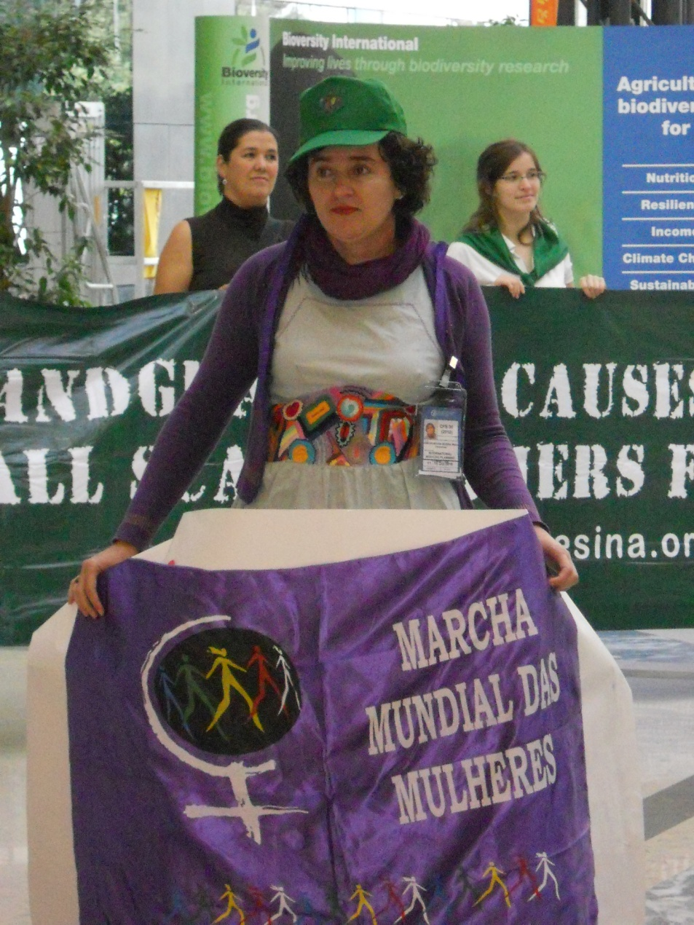
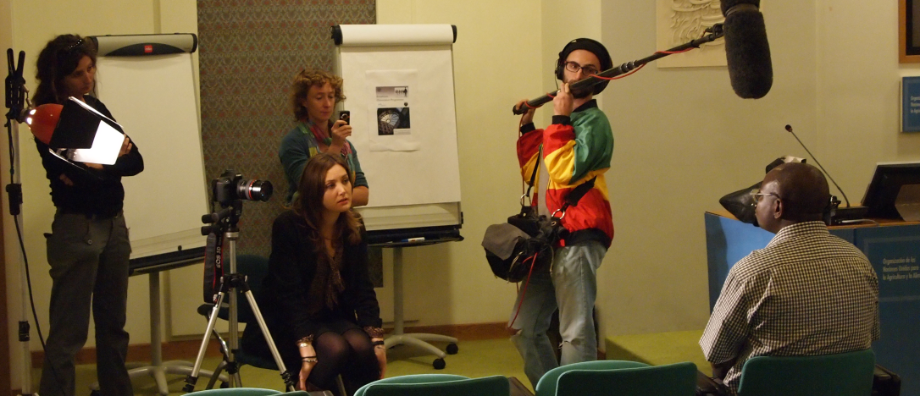

Slide 17
Key Challenges
Speaking social movement(s) and across cultures
Research/participant binary is critical
Negotiation of power relations, responsibilities and hierarchy within the constraints of the research project
  How to assessing truth claims (avoid locking participants into a time and place of meaning (Domosh 2003)
  Ontological argument for viewing experiences and broader processes as mutually constitutive
Researcher-CSO dynamics (shifting role)
  Insider, outsider, both and neither (Mullings 1999)

Slide 18

Key Challenges cont.
Gender politics
  Bargaining with Patriarchy (Kandiyoti 1988, 1998)
Time- methodological tension in ethnography
Dealing with political sensitive analysis
  Academic expectations vs solidarity vs capacity
Protecting participants
Emotion (highs/lows)
  How to address this personally & academically
  Getting too involved?

Slide 19
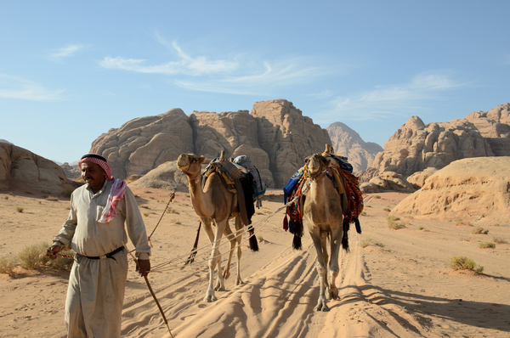
PART 3- Voluntary Guidelines on the Responsible Governance of Tenure

Slide 20
What are the VGGTs
Guidelines to promote responsible governance of tenure of land, fisheries and forests, with respect to all forms of tenure: public, private, communal, indigenous, customary, and informal
Goals: achieve food security for all & support the progressive realization of the right to adequate food
Best practices for governance of tenure of natural resources
Strengthen the capacities and operations of actors
Tool to assess land tenure policy

Slide 21
What they are not
Not targeted at land grab
Not enforceable
Why should we care?
Secure tenure rights are fundamental to food security
International standards to ensure responsible governance of natural resources
HR-based instrument- shifts focus of land policies to the implementation of the RTF and in turn disadvantage people

Slide 22
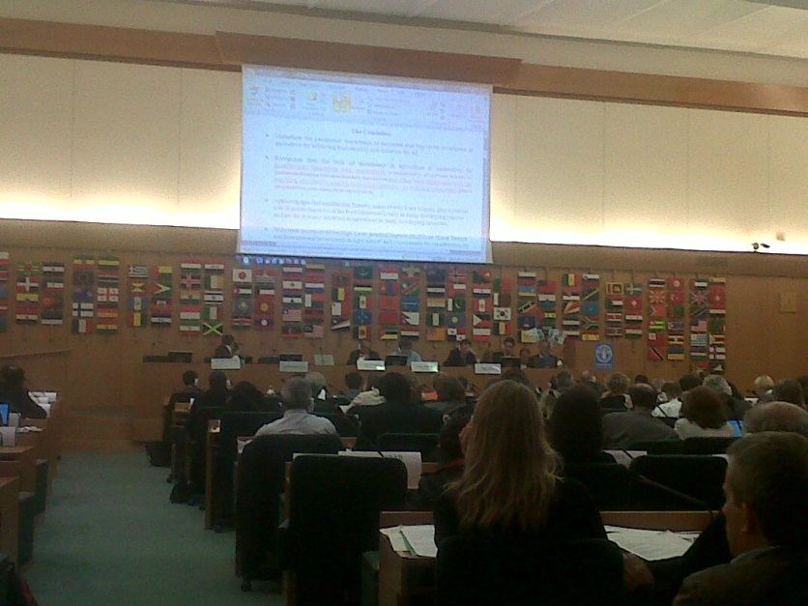
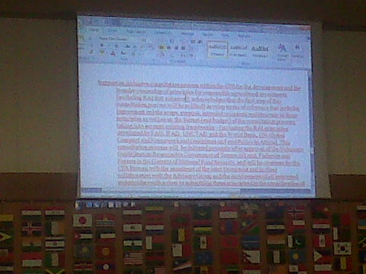
Negotiation the Guidelines
Key issues for CSOs
  Rights-based approach
  Food security goals
  Principles of inclusion: list of small-scale producers
  Investment in association with land holders, different models of production and land use, informal tenure systems
  Monitoring
Tension between success of process and quality of document

Slide 23
Guiding Principles
General Principles
Principles of implementation
States to recognise and respect all legitimate tenure right holders
Safeguard legitimate tenure rights
Provide access to justice to deal with infringement of legitimate tenure rights
Non-state actors including businesses have a responsibility to respect human rights and legitimate tenure rights
Human dignity
Non-discrimination
Equity and justice
Gender equality
Holistic and sustainable approach
Consultation and participation (taking into consideration existing power imbalances)
Rule of law
Transparency
Accountability
Continuous improvement

Slide 24
What do the VGGTs cover?
Legal recognition and allocation of tenure rights and duties
  Safeguards; Public resources; Indigenous Peoples; Informal tenure
Transfer and other changes to tenure rights and duties
  Markets; Investments; Land consolidation; Restitution; Redistributive reform
Administration of tenure
  Record of tenure rights; Valuation; Taxation; Resolution of disputes; Transboundary matters
Responses to climate change and emergencies
  Climate change; Natural disasters; Conflict
Promotion, implementation, monitoring and evaluation

Slide 25
Assessment of the VGGTs
Pros
Consultative and inclusive process for developing the Guidelines
CSOs participated at all stages including the negotiations, to draw attention to the real-life issues facing them and to make concrete proposals
VGGTs respect and protect human rights in the context of tenure
Emphasis is on women, peasant farmers, fishing communities, pastoralists and indigenous peoples
Principles of implementation, Evidence of the capacity of the CFS

Slide 26
Assessment of the VGGTs
Cons
Do not explicitly challenge assumption that large-scale investments in industrial agriculture, fisheries and forests are essential for development
Did not prioritise support to small-scale food producer groups
VGGTs do not consolidated the recognized rights of indigenous peoples, as articulated in UNDRIP and other international instruments, in the context of tenure
Water resources were excluded from the scope of the VGGTs = gap that challenges the relevance of the Guidelines in many regions
Enthousiasm v Political Will to take up the VGGT at the national level
Framed in the context of developing countries

Slide 27
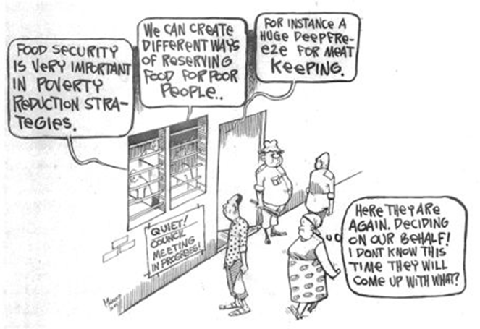
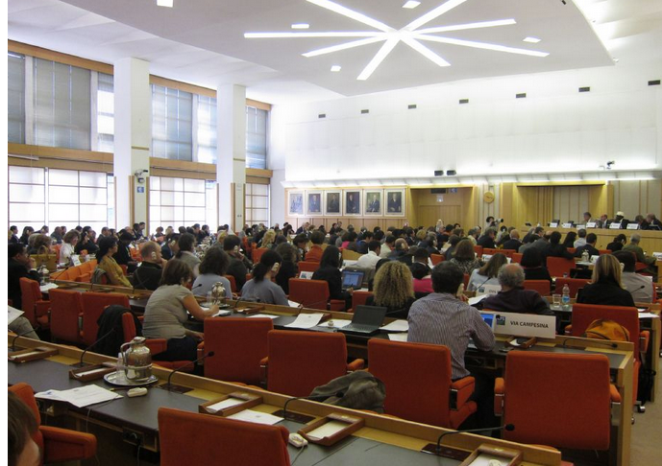
Limitations of Food Security
Technocratic definition and approach
Apolitical: fails to accept the political processes that contribute to food insecurity
States are being asked to monitor their own progress and to prioritise development
States predominantly continue to prioritise economic values: food security as an outcome of strong economy

Slide 28
Policies Against Hunger 2013
Recommendations from the Conference
Working Group 1: Governing Land Responsibility
  Build on existing experiences; safeguards processes; VGGT is technical process and also social and political issue; build up complaint and dispute resolution mechanisms
Working Group 2: Conflicts over Land
  VGGT to break cycles of conflict; states to incorporate the VGGT in national law and policy; recognise and strengthen customary tenure
  CFS play role to exchange best practice in achieving effective integration of formal and customary systems for resolving tenure disputes- customary systems are not universally positive- need to address their shortcomings from a rights-based perspective being careful not to jeopardize legitimacy
  UN HR expert study on integrating customary systems and principles with human rights law- possible HRC Expert Advisory Committee

Slide 29
Policies Against Hunger 2013
Recommendations from the Conference
Working Group 3: Investment in Land
  national multi-stakeholder platforms; VGGTs as standard when entering into cooperation with other countries; Set up monitoring and complaint mechanism CSOs to disseminate VG message, monitor investments and us VGGT as yardstick and report to governments and CFS
  Financial investors to apply VGGTs in their operations
Working Group 4: Monitoring Progress towards Decisions and Recommendations
  CFS to assess progress towards implementation, short, medium, long term
  Link national and regional processes and platforms
  Develop quantitative and qualitative indicators reflecting principles of GSF (para 92 & 93)
  Support capacity building for monitoring and evaluation to enhance accountability

Slide 30
Now what?
There is an assumption about the goodwill to implement but implementing guidelines on such a contentious issue will be tricky
These guidelines are voluntary, so what do we do?
  based on HR approaches. We can encourage countries that have traditionally championed human rights to take the lead
Explore how to use mandatory HR monitoring and see how we can link
Need to have mechanisms to hold all investors to account
Implementation cannot happen without accountability which will not happen without monitoring
Monitoring is the first steps to moving towards real implementation: “to move from paper to justice”

Slide 31
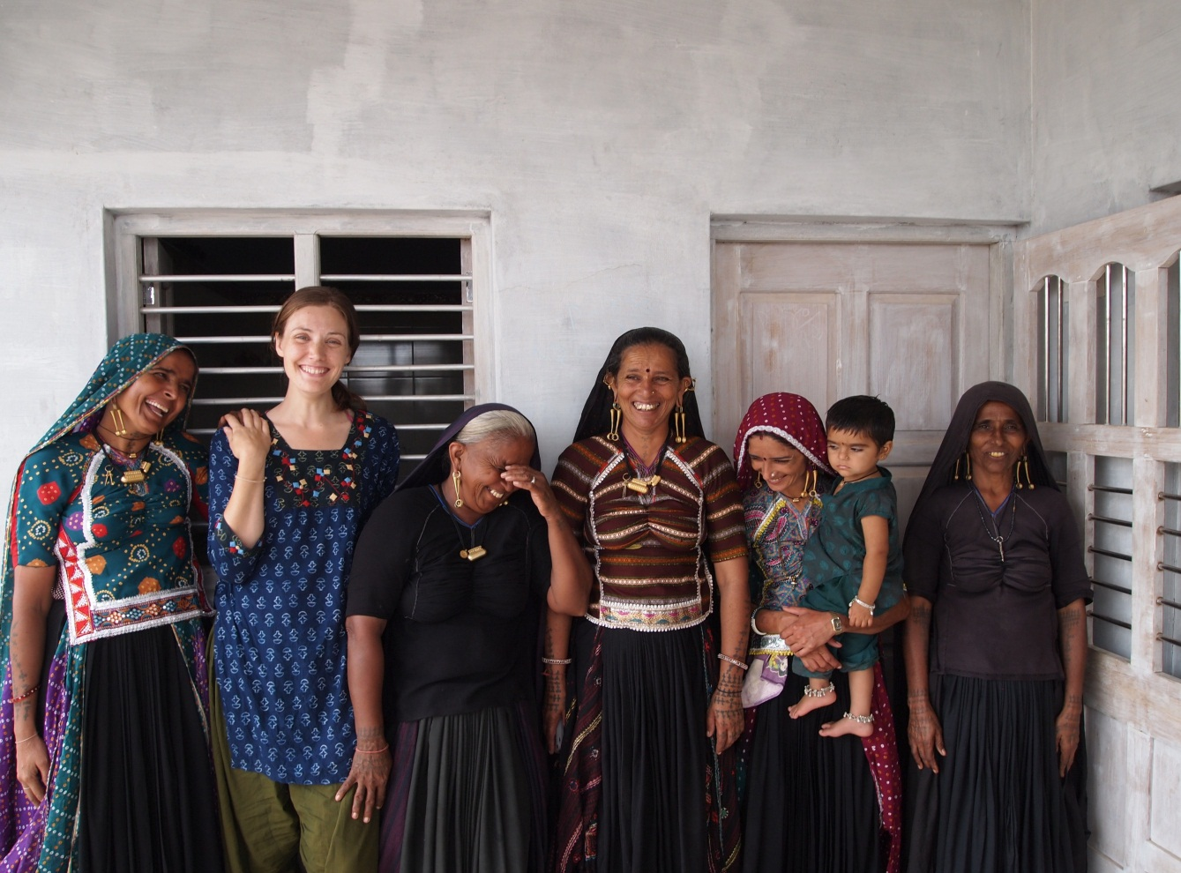
Thank You
Contact/Questions
jessica.duncan.2@city.ac.uk
Download Presentation
foodgovernance.com

Slide 32
Key Issues Remaining
Communication
  Translation
  Maintaining politically negotiated language
Assessment
  How to use VGGT to assess national policies; coherence
Cohesion
  How to make the link between regional initiatives (AU Land Policy Initiative) and the VGGTs
Implementation
  Very political issue; how to raise political will?
  Regional level?
Monitoring
  Challenges of attribution
  Staged approach? Mixed methods: value of case studies
  Indicators: appropriate? Context dependent
  Assess end goal: improved tenure rights and food security

Slide 33
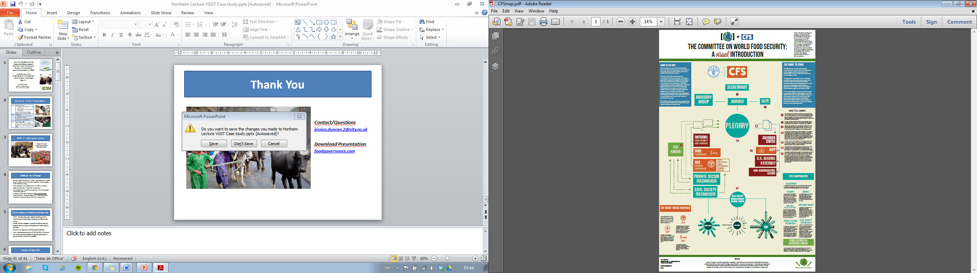

Slide 34

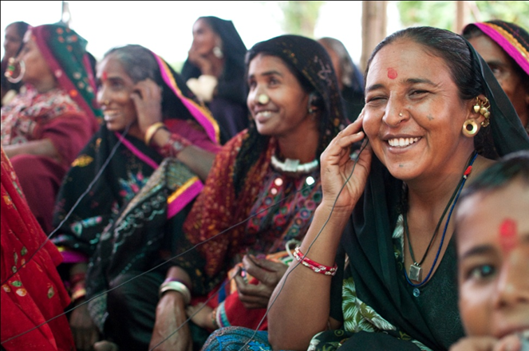
CSO engagement: Effective Strategies
Technical Capacity/ Knowledge
Political Savvy
Coherent Political Framework
Positivity
Linking back to the CFS’s Mandate & HLPE
Alliances
Legitimacy

Slide 35
Technical Capacity
Political Savvy
NGOs and social movements have people dedicated to working on key issues = high level of technical knowledge and expertise
Diversity of actors from many perspectives enhances this
They make strong interventions are often provide strong references to academic literature, international law, etc.
CSOs are increasingly competent and confident in the workings of the CFS
Able to assert themselves more effectively
Prepare clear strategies based on key demands, red lines and their own values in a consultative manner
Constant evaluation and reflection to inform strategy
Flexible in their approach
Social Movement v. NGO

Slide 36
Coherent Political Framework
Positivity
Food Sovereignty as unifying principles of a global social movement
Also a well articulated political framework
Undertakes a rigorous political analysis of agricultural policies and programmes with a focus on relations of power and control of resources
Production – not productionist – centred
CSOs make positive contributions
Generally aim to stay positive with interventions
Propose solutions to critique
Highlight their processes as a model of cohesion and consensus building
Even use humour at times

Slide 37
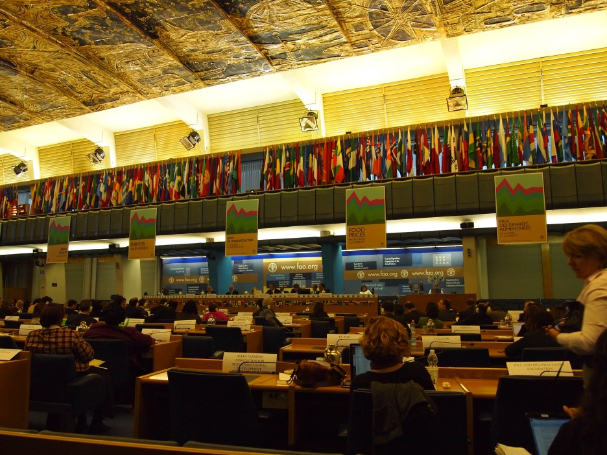
Linking back to the goals of the CFS
Alliances
Framing proposals within the context of the CFS mandate was successful
  Food security
  Most vulnerable populations
  Right to Food
Strong alliances amongst civil society have proven useful: speak as one
Alliances with countries and regions, including meetings to share positions, working on shared positions, seeking backing for amendments, has proven very powerful
CSO positions gain strength when backed by governments (and vice versa)

Slide 38
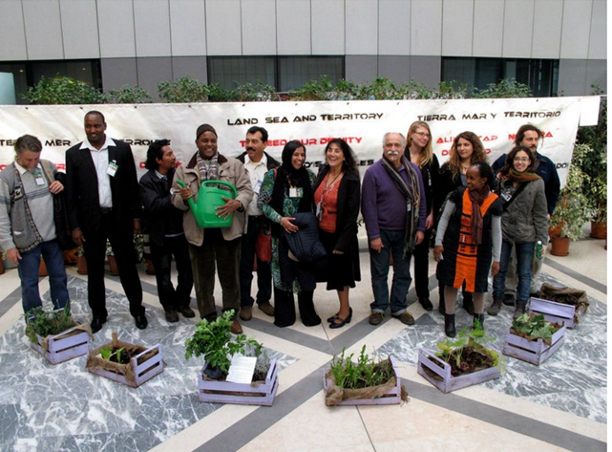
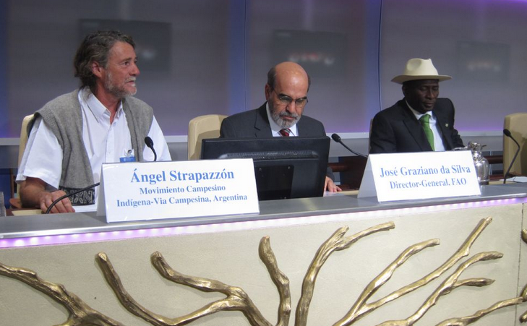
Legitimacy
CSO actors have the capacity to speak about on the impact of policies on their communities
They have more freedom to break through the political speak and call governments to account
AU holds a lot of legitimacy in these negotiations as well

Slide 39
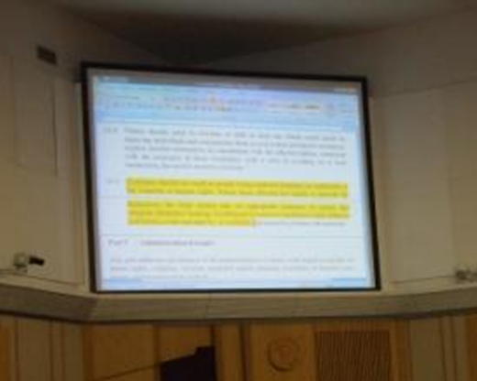
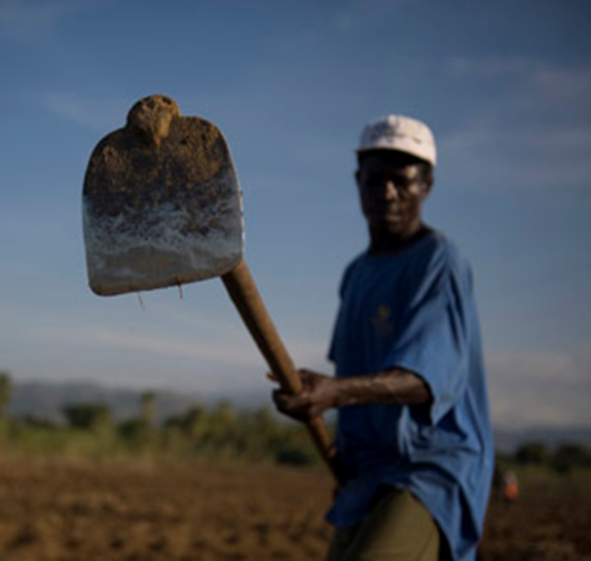
Challenges: CSO Participation
Language
Scope
Coherence
Power Politics
Limitations of Food Security

Slide 40
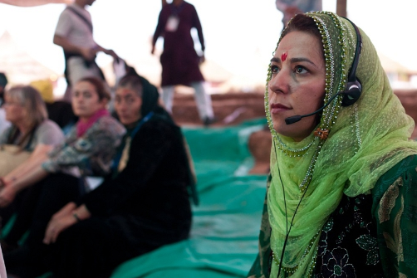
Language
Scope
Texts are negotiated in English, leaving many people out of the negotiations
Speaking social movement versus speaking UN
Tenure of natural resources security is complex and politically sensitive
Brings together many actors
  Challenges communicating across sectors
  Turf wars
  Political v. Technical Process

Slide 41
Coherence
Power Politics
Operating under notion that cohesion is lacking
CFS has a mandate to enhance cohesion
Questions about AU Land Policy Initiative
Cohesion is also a highly political process: which policies need to be changed and which are to be upheld?
  CSOs argue that the CFS policies are most legitimate because they are most inclusive
  Contrast = G8’s New Alliance or PRAI
Increased interest by financial actors (land grab, speculation, commodities trading)
  Rio +20 – Green Economy
Land is on the G8 Agenda: transparency
Shifting geopolitics (BRICS)
G8/G20

Slide 42
What Now?
Implementation has been encouraged by the G20, Rio+20, the Francophone Assembly of Parliamentarians and the UN General Assembly
FAO has made the VGGTs a priority
As of February 2013, the FAO had supported 10 awareness raising workshops, 17 country-level workshops had been requested and 53 briefings in 33 countries had been completed
Country requests received from Myanmar, Namibia, Philippines, Sierra Leone, Zambia, South Sudan
Capacity development tools: technical guides (e.g., gender, indigenous peoples), and e-learning programme

Slide 43
What Now: CSOs
Land Tenure Working Paper: Monitoring the VGGTs: A civil society perspective (FIAN International 2012)
IPC+ Working Group on Land and Territory on the Tenure Guidelines met in early February
WG has developed a proposal for a set of materials and activities on the Tenure Guidelines to be developed by social movements and CSOs for their own members
These activities include: elaborate a Capacity Building Manual; carry out capacity building workshops; develop audiovisual materials; and set up a common website for social movements’ platforms to share information on how the Guidelines are used in their struggles for access to resources

